Slide 1

Green Core
SUSHIL GIRI (LEADER)
ANIKET GITE
SAKSHI VYAVAHARE
SHREYA CHAVAN
POWER BI BASED
SOLAR VIRTULIZATION

Slide 2

Unlock insights on any data
Power BI overview
Turning data into a business advantage

Slide 3








The world of data is changing
10x increase every five years
Big
Data
Consumerization of IT
4.3 connected devices per adult
85% from new data types
27%
using social media input
“By 2015, organizations that build a modern information management system will outperform their peers financially by 20 percent.”
Notes:
Big Data – the size, type, shape of data that business are analyze is changing.
Data from sensors: RFID tags in manufacturing, or location data for company’s with large fleets.
Data from social media like facebook, twitter, Linked-In – for analyzing the success of a marketing campaign or to assess customer sentiment or to gather feedback to help shape products or services.
Public data – traffic or weather feeds, or data published from data.gov initiatives etc
Being able to easily tap into these data sources from smarter analytics to drive business insight is a prevalent theme.
Consumerization of IT – this is about choice. I as an individual want to work on the device of my choice. From wherever I want to work. This extends beyond devices to include apps and user experiences. I search for information all the time at home on the web, I want to have that same experience at the office. I’ll talk today about how we’re bringing these experiences to the world of data as well.

Slide 4



A powerful new way to work with data
Self-service business intelligence and analytics with Excel and the power of the cloud
Analyze in Excel
1 Billion Office Users
Collaborate in Power BI for Office 365
1 in 4 enterprise customers on Office 365
Discover
Analyze
Visualize
Share
Question
Mobility
Q&A
Scalable | Manageable | Trusted
Notes:
Our Approach:
Excel is the most commonly used analytical tool for business users – it truly is accessible to anyone. No other vendor has the ability to reach a billion users through tools they already know and use. Today Excel delivers end-to-end self-service BI functionality through capabilities such as Power Query, Power Pivot, Power View and Power Map. With the accessibility of Excel and proliferation of Office 365, we can lower the barrier of entry for businesses who want to take advantage of the benefits of business intelligence by putting the right analytics tools in everyone’s hands with no friction.
Ease of deployment through Office 365.. Power BI dramatically simplifies and reduces the time it takes for IT to setup and manage the complex infrastructure needed for an enterprise wide BI platform. Power BI enables businesses to balance between the needs of business users working in Excel and an IT department’s requirements for agility, monitoring and governance. IT can also provide business users the ability to search and access IT sanctioned corporate data sources both on premises and in the cloud while monitoring query usage against their data.

Slide 5
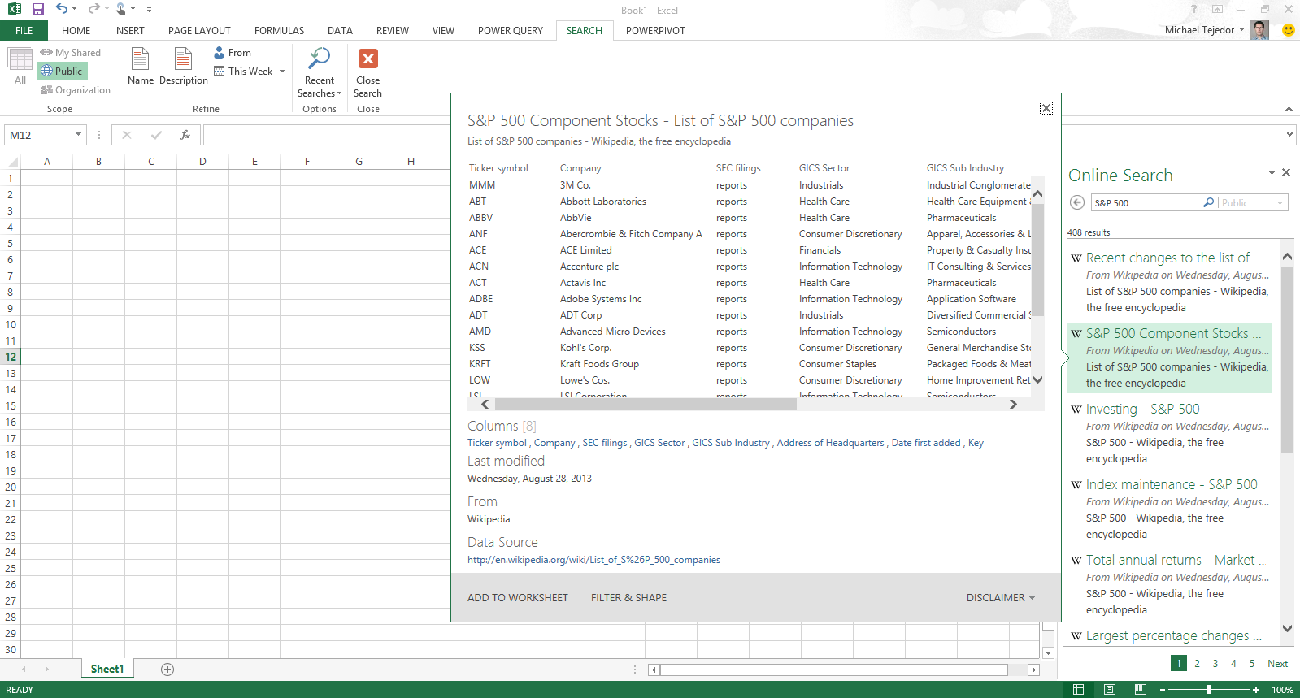
Analyzing data with Excel
Easily discover and access public and corporate data
Discover
Analyze
Visualize
Explore
Notes:
Powerful Self-Service BI in Excel 2013: We are taking our most powerful business intelligence solutions and building them directly into Excel.
There has never been such an abundance of available and useful information as there is today both across the web and across your organization. However, users are challenged with effectively discovering and connecting to this information so that they can gain the insights they need.
Power Query enables information workers with a familiar and intuitive experience for finding and connect to data from within Excel. Providing them with ease of combining and transforming this data so that it can be analyzed and visualized for deeper insight. Power Query supports a wide variety of data sources including relational, structured and semi-structured data, OData, data from the Web, Hadoop, as well as Data Search capabilities that provide users with a search experience for data, returning relevant data sets from across the enterprise and from external sources.

Slide 6
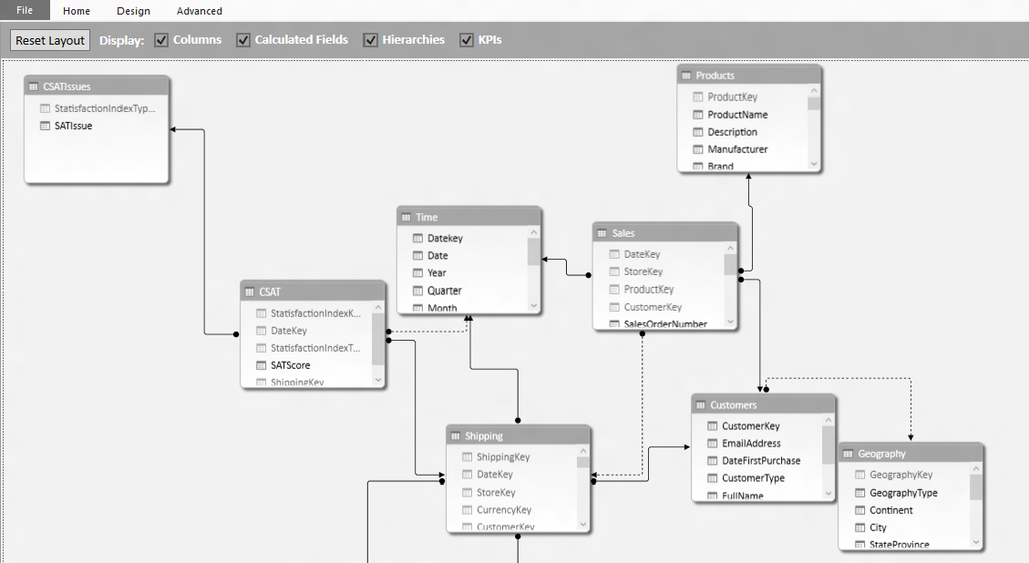
Analyzing data with Excel
Model & analyze 100’s of millions of rows of data
Discover
Analyze
Visualize
Explore
Notes:
Power Pivot allows Excel users continue to create sophisticated models with data in Excel by creating relationships, custom measures and calculations, hierarchies, and KPI’s. Power Pivot models process data in-memory so that users can analyze 100’s of millions of rows of data with lightning fast performance. Power Pivot also compresses the data to reduce file sizes.

Slide 7
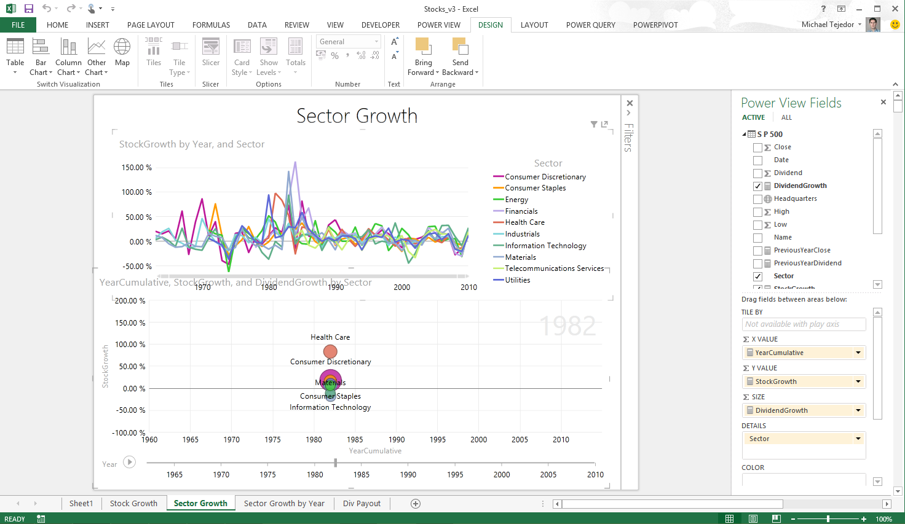
Analyzing data with Excel
Explore your data with interactive visualization
Discover
Analyze
Visualize
Explore
Notes:
In Excel 2013 we also introduced a host of new visual capabilitie. Quick Analysis provided immediate views of various visualization options and reduced the time to add them on your data, Chart Recommendations used intelligent heuristics to suggest charts. The charting functionality provided live preview, richer data labels, and easier ways to add chart elements, apply styles, and filter directly from the charts.
Excel 2013 also introduced Power View, and with it brought beautiful interactivity to visualizations and more fluid exploration capabilities.
Power View easily creates visual reports and analytical views through interactive charts and graphs that help you explore and present your data in bold new ways in Excel. Customers can create dashboards of interactive visualizations that provide instant answers to variety of questions. This capability has resonated well with our customers, one of whom mentioned the rigidity of static snapshots during meetings has been replaced by the “Power View lifestyle”, their term for the transformational way of presenting and using information.

Slide 8
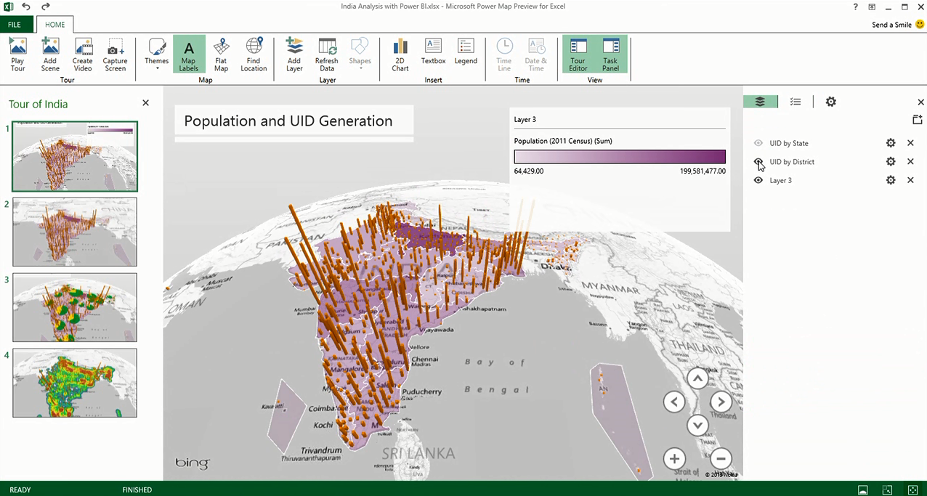
Analyzing data with Excel
Uncover new insights with 3D geospatial analysis
Discover
Analyze
Visualize
Explore
Notes:
Increasingly, we have access to geospatial data, and recently introduced Power Map brings new 3D visualization tool for mapping, exploring, and interacting with geographical and temporal data to Excel, enabling people to discover and share new insights such as trends, patterns, and outliers in their data over time. In addition, with Power Map, users can easily capture and distribute their insights in the form of an interactive movie, telling compelling stories about their data.
Inspiration for Power Map came from Microsoft Research’s WorldWide Telescope project. Launched in 2008, WorldWide Telescope is used by the astronomy community to visualize imagery and data, essentially giving astronomers an observatory in a PC.
What’s Next?
The importance for data visualization is on the rise. Deeper interactivity that blend analysis and visualizations even more fluidly, newer types of visualizations that enable you to see deeper insights more easily, richer experiences on the devices customers use most, and great storytelling experiences are just a few of the areas we’re investing in to make sure Excel remains the data productivity app of choice as our customer needs evolve.

Slide 9
Real-world example: Miami Heat
The Miami Heat used Power BI to boost season ticket sales by 30% and save $1 million on operations.
Power BI adoption in the Miami Heat is 70% across the organization.
Power BI transformed customer interactions and business operations for the Miami Heat.

Slide 10
Expanding on Data Cleaning and Transformation in Power BI
Data is the lifeblood of any analytics project, and when working with data from various sources in Power BI, it's common to encounter challenges related to data quality, structure, and formatting.
Data cleaning and transformation are vital processes that ensure your data is in the right shape for meaningful analysis. This comprehensive guide will delve deeper into these essential aspects of data preparation in Power BI.

Slide 11

THANK YOU

